Slide 1
Rules for 3-to-15: 1. Two players alternate turns. 2. On your turn, pick a number from 1 to 9. 3. You may not pick a number that has already been picked by either player. If you have a set of exactly 3 numbers that sum to 15, you win. Can you represent this on a space?
game : thought experiment by Marc LeBlanc

Slide 2
Game Elements - Mechanics
M1 – SPACE
M2 – Objects, Attributes and States
M3 – Actions
M4 – Rules
M5 – Skill
M6 - Chance

Slide 3
Goals
From ‘A Theory of Fun’ by Raph Koster. Game mechanics are rule based systems / simulations that facilitate and encourage a user to explore and learn the properties of their possibility space through the use of feedback mechanisms.
While goals

Slide 4
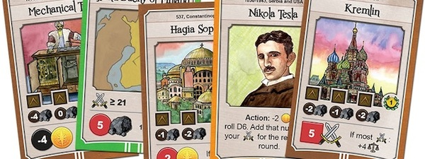
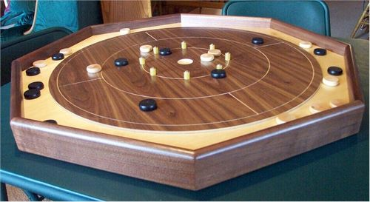
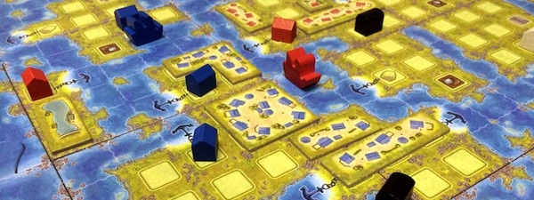
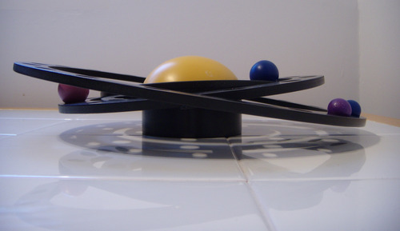
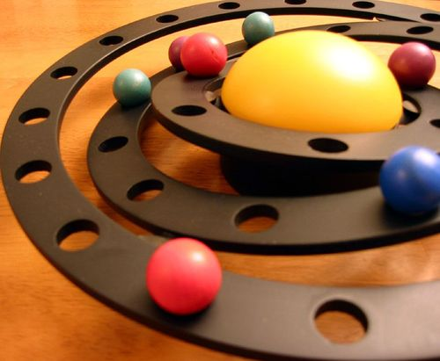
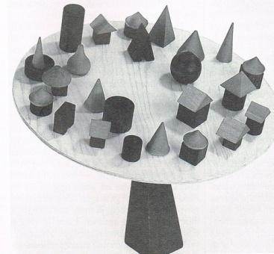
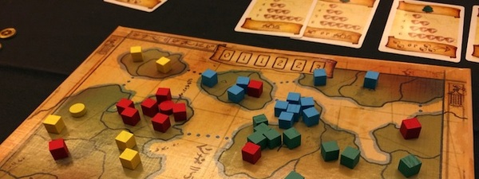
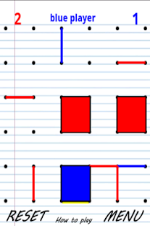
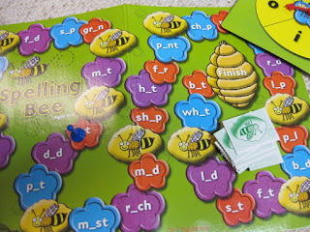
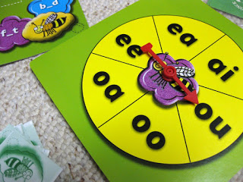
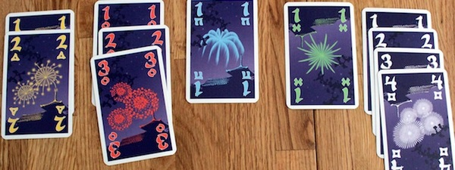
Crokinole
Amerigo
Nations
Eight Minute Empire
Bamboleo
Saturn
Connect the dots
Spelling Bee Early Literacy Board Game
Hanabi

Slide 5
Most important Rule: Good game goals
Good game goals have three important qualities. Good goals are:
1. Concrete. Players understand and can clearly state what they are supposed to achieve.
2. Achievable. Players need to think that they have a chance of achieving the goal. If it seems impossible to them, they will quickly give up.
3. Rewarding. A lot goes into making an achieved goal rewarding.

Slide 6
Lens #25: The Lens of Goals
To ensure the goals of your game are appropriate and well-balanced, ask yourself these questions:
What is ultimate goal of my game?
Is that goal clear to players?
If there is a series of goals, do the players understand that?
Are the different goals related to each other in a meaningful way?
Are my goals concrete, achievable and rewarding?
Do I have a good balance of short and long term goals?
Do players have a chance to decide on their own goals?

Slide 7
Mechanic 3 - ACTION

Slide 8
Actions in a checkers game ?
Operative actions?
Move a checker forward
Jump an opponent’s checker
Move a checker backwards (Kings only)
Resultant actions?
Protect a checker from being captured.
Force an opponent into making an unwanted jump.
Sacrifice a checker to trick his opponent…..
Would you consider resultant actions as rules?

Slide 9
Action – verb
add more operative actions
Verbs that can act on many objects
Goals that can be achieved more than one way.
Many subjects
Side effects that change constraints

Slide 10
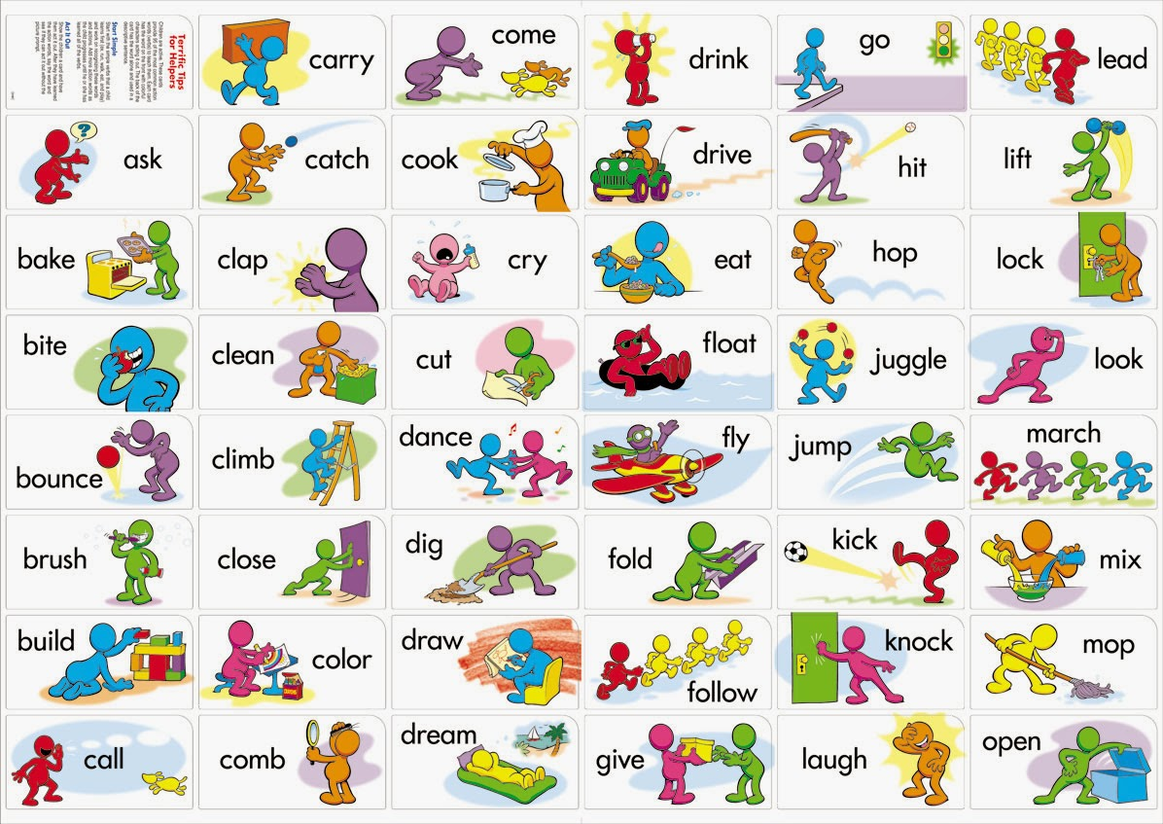

Slide 11

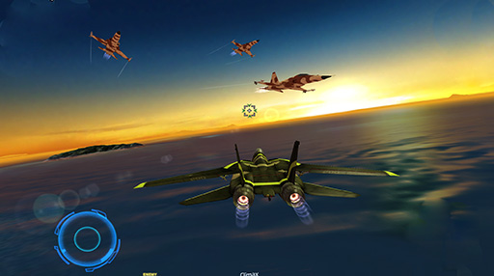
Examples- Action games
Wheel jumps - leap, somersault, propel
dodging missiles and shooting down enemy aircraft,

Slide 12
Lens #24: The Lens of Action
What are the operational actions in my game?
What are the resultant actions?
What resultant actions would I like to see? How can I change my game in order to make those possible?
Am I happy with the ratio of resultant to operational actions?
What actions do players wish they could do in my game that they cannot? Can I somehow enable these, either as operational or resultant actions?

Slide 13
Lens #23: The Lens of Emergence
How many verbs do my players have?
How many objects can each verb act on?
How many ways can players achieve their goals?
How many subjects do the players control?
How do side effects change constraints?

Slide 14
Mechanic 4: Rules

Slide 15
The rules are really the most fundamental mechanic. They define the space, the objects, the actions, the consequences of the actions, the constraints on the actions, and the goals.

Slide 16
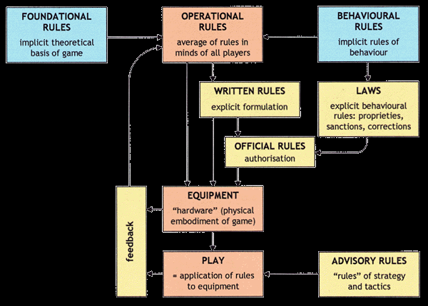
Parlett’s Rule Analysis
FR: Abstract – “ player’s power will increase by random number from 1-6”
OR: “what the players do to play the game”
Constituative - These rules are "the abstract, core mathematical rules of a game“.
Operational - These are the "rules of play" that guide the game and direct and determine the gamers' behaviour.
Implicit - These are the rules that are not expressly stated within an instruction book, but are appreciated by players.
Notes:
Official rules: In chess when player makes a move that puts the opponents king in danger of a checkmate, the player is obligated to warn the other by saying ‘check’. At one time this was a ‘law’, nit a written rule but now a part of the official rules.

Slide 17
Summarizing:
Operational Rules “What the players do to play the game.”
Foundational Rules: The foundational rules are the underlying formal structure of the game.
Behavioral Rules: These are rules that are implicit to gameplay, which most people naturally understand as part of “good sportsmanship.” For example, during a game of chess, one should not tickle the other player while they are trying to think, or take five hours to make a move.
Example: The operational rules might say “The player should roll a six-sided die, and collect that many power chips.” The foundational rules would be more abstract: “The player’s power value is increased by a random number from 1 to 6.”
Distinguish : Rules and Strategy
One note of clarification about the difference between the rules of a game and rules of strategy: rules as we understand them here as the formal structure of a game are not the same thing as strategies for play, even though the two might seem similar.

Slide 18
Snakes & Ladders
Operational rules:
Everyone spins the spinner
On your turn, spin the spinner and move your pawn.
Going Up or Down a Chute or Ladder:
Constituative rules
1. Players all begin with a value of zero.
2. Players alternate turns adding a random number of 1–6 to their current value.
3. The first player to reach a value of exactly 100 wins.
Whereas operational rules are concrete and describe specific actions that players will take, the constitutive rules are abstract

Slide 19
Can we do this?
What if the constituative rules of snakes and Ladders were simplified in the following manner:
1. Players all begin with a value of zero.
2. Players alternate turns generating a number and adding it to their value.
3. The first player to reach a value of 100 wins.
Or simplified even further:
1. Players begin with a value of zero.
2. The first player to reach a value of 100 wins.
Or even further:
1. The first player to satisfy the victory conditions is the winner.

Slide 20
Lens #26: The Lens of Rules
To use this lens, look deep into your game, until you can make out its most basic structure. Ask yourself these questions:
What are the foundational rules of my game? How do these differ from the operational rules?
Are there “laws” or “house rules” that are forming as the game develops? Should these be incorporated into my game directly?
Are there different modes in my game? Do these modes make things simpler, or more complex? Would the game be better with fewer modes? More modes?
Who enforces the rules?
Are the rules easy to understand, or is there confusion about them? If there is confusion, should I fix it by changing the rules, or by explaining them more clearly?

Slide 21
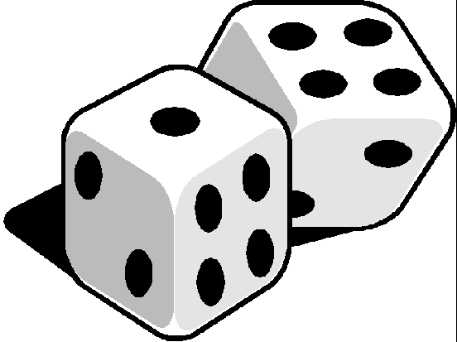
Mechanic 5 - Skill
From game to Player

Slide 22
Player skills
Physical skill
Mental skills
Social skills
Real vs. virtual skill
Lens #27: The lens of skill
What skills does my game require of the player?
Are there categories of skill that this game is missing?
Which skills are dominant?
Can players improve their skills with practice?
Notes:
Social skills – knowing what the other is thinking, fooling an opponent. Poker is all about concealing your thoughts.

Slide 23
Game Balance

Slide 24
Balancing act!!
Within a game, if there are multiple strategies or paths to victory that can be followed within the game, we use “balance” to describe whether following one strategy is better or worse than following another.
Beautiful art, technology, story
Game success
Monotonous, confusing, frustrating
Time

Slide 25
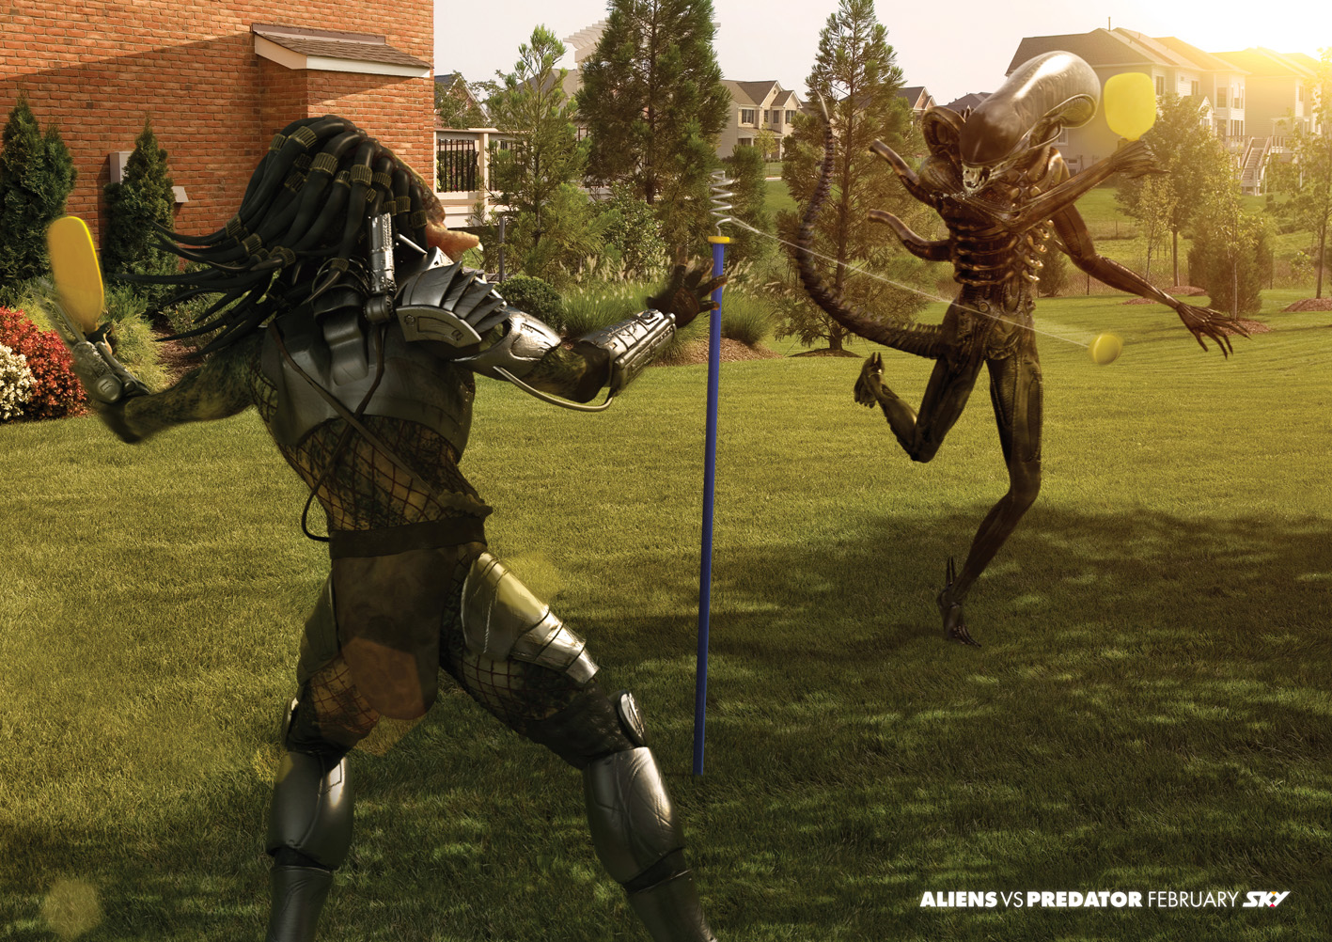
#1: fairness
Game should be symmetrical to give a perception of fairness if not real.
That is, equal powers to all resources and powers to all players.
Q’s;
In cricket, does the team that wins the toss have a slight advantage?
In chess, does first mover really win? – think of an alternate way to address this?
Fairness when skill levels are not-equal?
Asymmetrical games: makes for interesting game play
That is: opponents have different resources and abilities
Q’s:
Real life is asymmetrical?
Asymmetry adds intrigue to the game?
In pac-man game who has the advantage? – the ghosts or pac man?

Slide 26
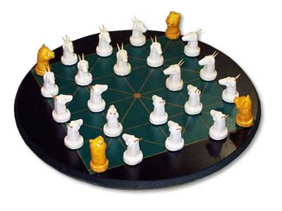
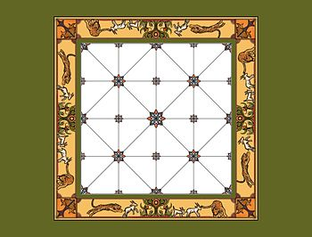
Bagh Chall – an asymmetrical game Unequal forces & different goals
http://bagchal.rat32.com/
One opponent plays four tiger pieces and the other plays twenty goats. Is this game balanced at all?

Slide 27
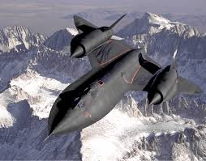
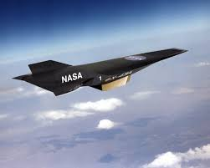
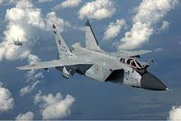
Balancing resources & powers
Plane | Speed | Manoeuvrability | Firepower
SR-71 | Medium | Medium | Medium
X-43A | High | High | low
MIG-31 | low | low | high
By changing the score values for the ‘powers’ let’s balance the resources
The lens of fairness: Lens #30
Should my game be symmetrical or asymmetrical ? Why?
Do I want to test skill or give a challenge?
For players of different levels, how can I make the game interesting and challenging to all?
.

Slide 28
Rock,paper,scissors
Rock breaks scissors
Scissors cut paper
Papers cover rock
- balance of fairness maintained, as you outdo an advantage by adding ‘higher’ advantage over it!
The proportion of each throw to be equal to the others: there should be a 1:1:1 ratio.
Now, suppose you modify the game slightly, so that each win with Rock scores 3 points, a win with Paper scores 2 points, and a win with Scissors scores 1 point

Slide 29
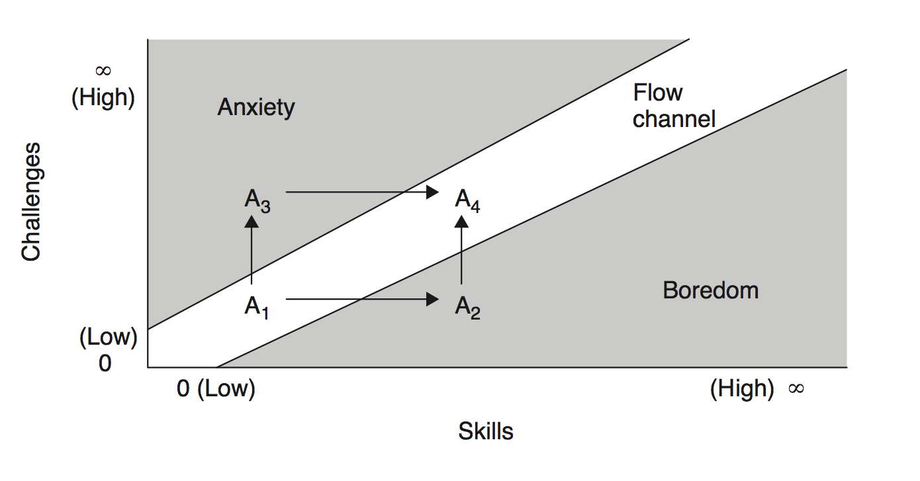
Balance # 2: Challenge vs. Success
Lens #31: The lens of Challenge
What are the challenges in my game?
Are they easy,hard or just right?
Can the challenges fit all skill levels?
Variety in challenges?

Slide 30
Hardest game!
Don't Get Hit By Blue Balls! Keep your Red Square away from the
Blue Balls on your way to the Green Zone or you'll DIE! And trust us;
you'll die. A lot.
http://www.snubbyland.com/
http://www.snubbyland.com/about.php#stevie

Slide 31
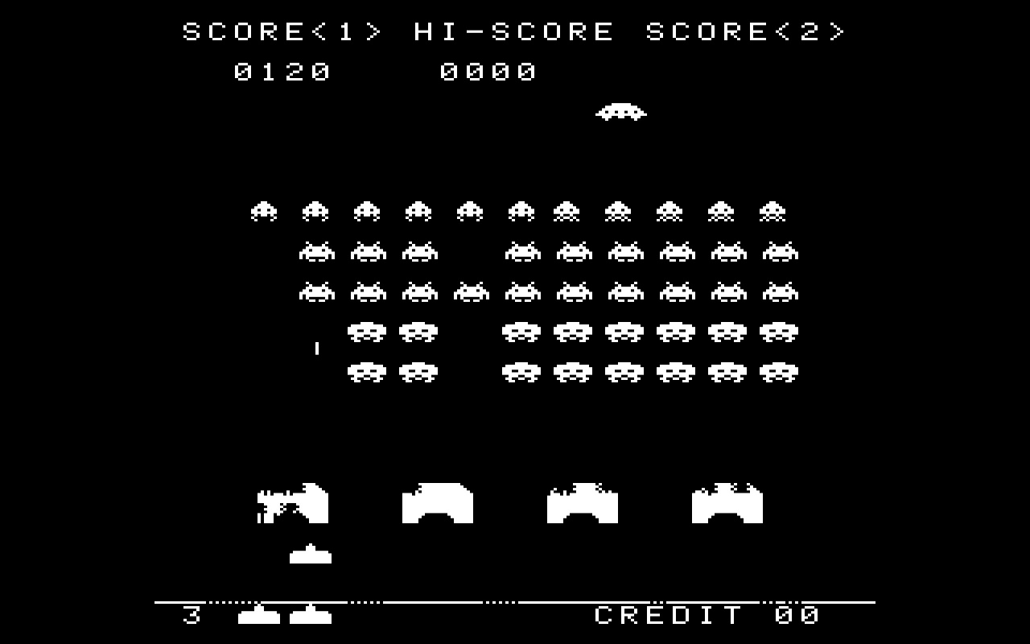
Balance # 3: Meaningful choices to players
Low risk
/low reward
High risk/high reward
Lens#32:
What choices & how meaningful?
Right choices to empower the player?
Any dominant strategies in my game?
Player
Designers should figure out the types & number of things the player would like to do!.

Slide 32
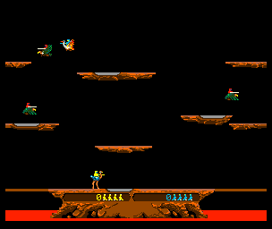
Competition vs. Cooperation
Example: Joust
- competitive : players get points based on how many enemies they defeat.
- cooperative: players get higher score if they coordinate their attacks and protect each other.
Decision of the player:
Try and beat each other – highest relative score
Beat the game (highest absolute score)

Slide 33
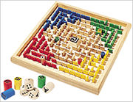
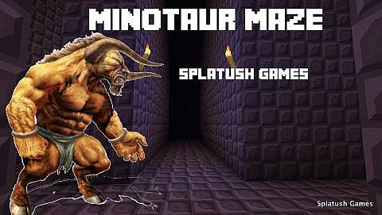
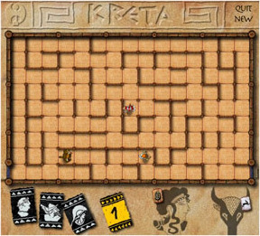
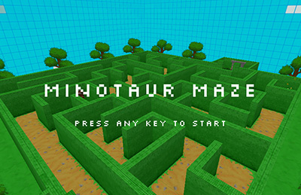
Short vs.long
Stalemate can be reached if there is no confrontation and hence gets boring
Designers solution?

Slide 34
Summary: Balances Types
1. Fairness
2. Challenges vs. Success
3. Meaningful choices
4. Skill vs. Chance (opposing?)
5. Heads vs. Hands
6. Competition vs. Cooperation – example of balance is ‘Joust’
7. Short vs.long
8. Rewards – sounds, points, more plat time,power,resources,
9. Punishment
10. Freedom vs. controlled experience
11. Simple vs. complex – emergent (go) and innate complexity (chess)
12. Detail vs. imagination

Slide 35
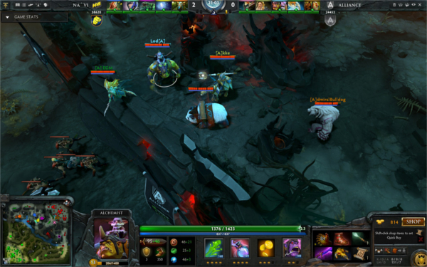
Acclaimed or rated most balanced games
DOTA 2
Chess
Bulletstrom
Example of the most unbalanced game?
RTS
RPG
In general, there are three ways to balance games:
Use math.
Use your instincts as a game designer. Change the balance in the game until it “feels right” to you.
Use playtesting. Adjust the game based on the results of playtests, where the players are experienced gamers who have been instructed to play to exploit and win.

Slide 36
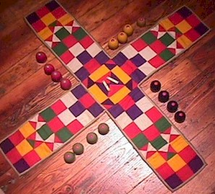
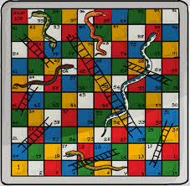
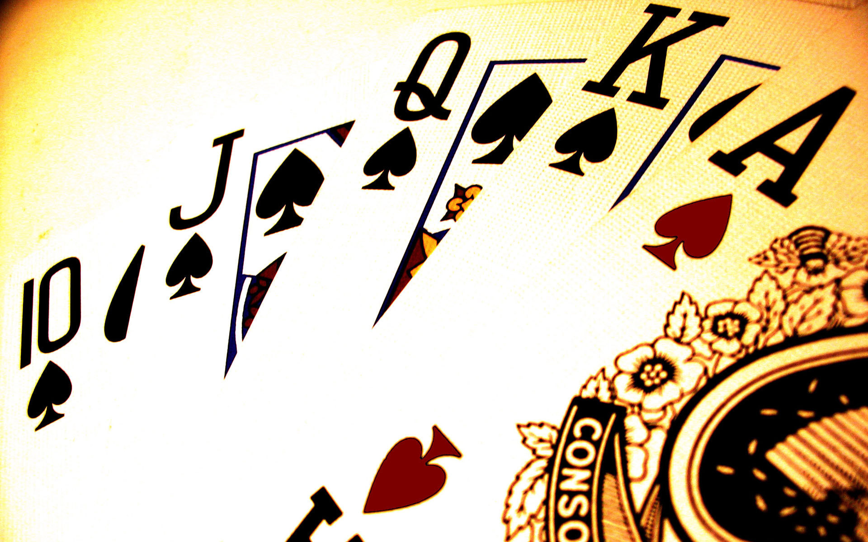
Skill vs. Chance
S & C?
C only?
Starts with C but S to win?

Slide 37
Class work….
In a town there are 2 gold miners, and four locations each can visit: the mines, a bank to deposit the gold nuggets, a home and a bar/restaurant. Both are human players. Each player can either mine and get a nugget or steal from the other before it is deposited in the bank. The player can get really thirsty and tired if a lot of time is spent in the mine and hence the first stop at that state will be either the bar or home. Write a logic for a challenging game play from this narrative - include reasonable conditions.

